Slide 1




[Inquiry Circle] Meeting Script
example template, 75-90min. please use/edit/rerelease to your needs.
OPENING
• Sit: "Welcome friends. Let's start with a [3-minute] sit to get recentered." 🔔
• Guidelines: "I have asked ___ to read our core guidelines."
• Check-ins: "Let's do a round of ~2 minute check-ins. Who'd like to check-in?"
WRITING [IF DESIRED]
• "Thanks all. Let's write for [M] minutes on today's inquiry questions. If you've already done them feel free to relax of use this time to collect your thoughts or reflect!" "
SHARING
• Mutual Respect: "As a reminder for our healing space, this is a camera-on meeting, when possible."
• Inquiries: "Who would like to share their inquiries?" Timekeeper: Calculate [People]/[Minutes] to calculate times.)
Shares: Each person shares.
Gratitude: "Thank you for sharing your experience!"
CLOSING
• Check-out: "Thanks everyone. Let's do a check-out with feelings words or one sentence."
• Merit: "I've asked ___ to read our dedication of merit." 🔔
• Closing: "Next week we'll cover ___. If you're struggling, message/call/voicemail to ask for help. Have a good week!"
[recommended] MONTHLY GROUP INTENTIONS
• "What about the Inquiry Circle process is going well for you?"
• "What about the Inquiry Circle process might be improved, or make it even safer for you?"
• "We encourage a regular rotation of facilitation. A co-host can always help share screen."
(share screen: http://inquiry.rd.rocks )
Notes:
OPENING (~5 min)
0 min • Facilitator: e.g. "Welcome friends. Let's start with a 3-minute sit to fully arrive here now." 🔔
3 min • Facilitator: e.g. 🔔 "May all beings be free of suffering."
2 min • Facilitator: e.g. "Would someone like to read our guidelines?" Share: e.g. guidelines.rd.rocks
CHECK-INS + SHARING (~60-75 min)
Facilitator: "Let's do a round of 60sec check-ins. It's OK to pass!" (People check-in)
Facilitator: Get timekeeper. Decide share lengths. Ask, "Who'd like to share on their inquiries?"
Timekeep: Decide when to offer heads-up: e.g. "5 minutes left, thx" …⏳… "and time to wrap, thanks”
• Sharer: Share key insights of inquiries. (Once done, sharer can say "I'll pass on reflections.")
• Facilitator: "Thank you. [Are you open to supportive reflections?]"
• Reflector: e.g. Each can be as simple and valid as: “Thank you for sharing your experience.”
CLOSING (~5 min)
4 min: "Thanks everyone. Let's each check-out with feelings words or a sentence."
1 min: Ask volunteer to read a merit/mantra/prayer of choice. Once done:
🔔🔔🔔 "See you next week. Make calls or voice-messages. Reach out if struggling!"
[recommended] GROUP INTENTIONS (~monthly)
What's good? Unmet needs? Improvements? Voice your struggles. Rotating leadership? Other?

Slide 2

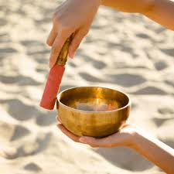

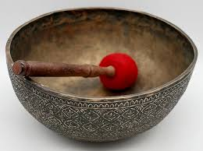


Meditation Bells
for Zoom Meetings
Remember to Share Sound before clicking. |  | High Small | Mid Crystal | Low Large | Deep Standing Bowl
Hit the bowl: 1x time | 15s
3x times, normal speed | 15s
3x times, slowly | 30s
 |  | portia | portia | portia | thom
Offered by friends from the West Coast Wind Down meeting
(share this: http://bells.rd.rocks )

Slide 3


Meditation Bells
for Zoom Meetings
Remember to Share Sound before clicking. |  | High (Small) | Middle (Crystal) | Low (Large) | Deepest (Standing Bowl)
Hit the bowl: 1x time | 15s
3x times, normal speed | 15s
3x times, slowly | 30s
 |  | portia | portia | portia | thom
Offered by friends from the West Coast Wind Down meeting
(share this: http://bells.rd.rocks )
Notes:
Small
https://youtu.be/uoTSfORWSg0
https://youtu.be/NzKlcyoPSUE
https://youtu.be/EksN0k2GdfA
Mid crystal
https://youtu.be/j7WILBWdEcM
https://youtu.be/Dgw1QFk4peM
https://youtu.be/j0p_F0sZ5Cc
Large Low
https://youtu.be/0GBqO4caML4
https://youtu.be/m3vamtmU_O0
https://youtu.be/v3-kqXF3NUg
Deep Standing
https://youtu.be/i1aMwJX-B60
https://youtu.be/x5MBbvu52_Q
https://youtu.be/B1MChMj18tY

Slide 4

Inquiry Sharing Guidelines
An example for Peacekeeping and Supportive Healing Spaces
Assume Goodwill: We assume that harm comes from a place of pain, fear, and confusion—all of us are unskillful at times.
Benevolence & Confidentiality: We listen deeply with compassion—we don't judge, shame, criticize, nor gossip.
Connection: We share on our addictions and mutually support one another.
Detachment: We ask for consent before offering suggestions, and "no" is OK for an answer.
Equality: As supportive equals, we hold space for healing & validating.
Focus: During sharing, we avoid "you" and focus on self-responsible "I" statements.
Generosity: When ready, we offer our experience to be of service.
Honoring Intimacy Boundaries: We honor the safety of our space by not using it to form romantic relationships.
(share screen: http://safespace.rd.rocks )
Notes:
example template for peacekeeping and supportive recovery practices
Assume Goodwill: We assume that harm comes from a place of pain, fear, and confusion—all of us are unskillful at times.
Benevolence: We listen deeply with compassion. We don't judge, shame, gossip, or criticize.
Connection: We tell on our addictions—we honor vulnerability and bravery.
Detachment: We don't give advice unless asked.
Equality: As equals, we hold a safe & validating healing space.
Focus: While sharing, we avoid using "you" to focus on self-responsible "I" statements.
Generosity: When ready, we offer our experience with inquiries and rise to be of service.
Honor & Freedom: We review these guidelines anytime and modify as appropriate.

Slide 5
The 5 Procepts
The 5 Mindfulness Trainings adapted for Recovery
It's not a typo. The focus of the 5 Precepts is negative: To commit to avoiding harmful behaviors. However, the focus of the 5 Procepts is positive: To commit to striving towards a beautiful goal.
This tiny shift of focus results in monumental impacts upon our recovery. For example, those of us suffering from conditioned sexual habits can entirely shift our fear-based behavior: ("I gotta stop my sexually compulsive habits 😞") to an admirable and positively-framed: ("Friends, I proudly strive towards a beautiful life of True Intimacy and Love 😌.")
The 5 Procepts represent a global spirituality and ethic, based on the Dharma:
Cherish Life: Aware of the suffering caused by harming life, I'm committed to cultivating the insight of interconnection & compassion, and learning ways to protect the lives of all beings (including my own)
True Happiness: Aware of the suffering caused by theft, exploitation, injustice, and oppression, I am committed to practicing generosity in my life.
True Intimacy and Love: Aware of the suffering caused by sexual misconduct and sexual trauma, I am committed to cultivating responsibility and learning ways to protect the safety and integrity of children, adults, partners, families, and society.
Loving Communication: Aware of the suffering caused by false speech and by not hearing, I am committed to cultivating loving speech and active listening.
Nourishment and Self-Care: Aware of the suffering caused by the toxicity of unmindful consumption, I am committed to cultivating good health for myself, my family, and my society by practicing mindful consumption—especially in terms of my own recovery. This includes mindfulness with certain toxic technologies, games, videos, literature, and conversations.
( For the unabridged, original 5 procepts, see: plumvillage.org/mindfulness/the-5-mindfulness-trainings )
( reshare this slide: http://procepts.rd.rocks )
Notes:
The 5 Mindfulness Trainings are uplifting visions of the 5 Precepts and offer concrete and inspiring goals for why we may have set the intention to recover. They represent a global spirituality and ethic based on the Dharma. [Summarized:]
❖
Reverence for Life. Aware of the suffering caused by the destruction of life, I am committed to cultivating the insight of interbeing and compassion and learning ways to protect the lives of all beings.
True Happiness. Aware of the suffering caused by greed, manipulation, injustice, stealing, and oppression, I am committed to practicing generosity in my life.
True Love. Aware of the suffering caused by sexual misconduct, I am committed to cultivating responsibility and learning ways to protect the safety and integrity of all.
Loving Speech and Deep Listening. Aware of the suffering caused by unmindful speech and by not hearing, I am committed to cultivating loving speech and active listening.
Nourishment and Healing. Aware of the suffering caused by unmindful consumption, I am committed to cultivating good health, both physical and mental, for my own self-care, my family, and my society by practicing mindful consumption, [especially in terms of my own recovery. This includes mindfulness with certain websites, games, technology, literature, conversations, substances, gambling].
❖

Slide 6



The Practice
(beginners version)
Renunciation: We commit to the intention of abstinence from addictive substances. For our process addictions, we identify needs, set boundaries, and practice healthy self-care.
Meditation: We commit to the intention of developing a daily meditation practice as an essential part of the program.
Meetings: In early recovery we attend meetings as often as we can. We actively participate and become of service when possible.
The Path: We deepen our understanding of the Four Noble Truths and practice the Eightfold Path in our daily lives. We cultivate the heart practices of Metta, Appreciation, Compassion, and Equanimity.
Inquiry & Investigation: We transcend our addictive habits by writing & sharing in-depth, detailed inquiries.
Sangha, Wise Friends, Mentors: We cultivate healthy relationships in our recovery community and we check-in with wise friends to stay on the path.
Growth: We undertake a lifelong journey of growth and awakening.
(share screen: http://slides.rd.rocks)
Notes:
Renunciation: We commit to the intention of abstinence from addictive substances. For our process addictions, we identify needs, set boundaries, and practice healthy self-care.
Meditation: We commit to the intention of developing a daily meditation practice as an essential part of the program.
Meetings: In early recovery we attend meetings as often as we can. We actively participate and become of service when possible.
The Path: We deepen our understanding of the Four Noble Truths and practice the Eightfold Path in our daily lives. We cultivate the heart practices of Metta, Appreciation, Compassion, and Equanimity.
Inquiry & Investigation: We transcend our addictive habits by writing & sharing in-depth, detailed inquiries.
Sangha, Wise Friends, Mentors: We cultivate healthy relationships in our recovery community and we check-in with wise friends to stay on the path.
Growth: We undertake a lifelong journey of growth and awakening.

Slide 7
The Four Noble Truths
(beginners version)
Having struggled with addiction, we're intimately familiar with suffering. Fortunately, the Buddha taught the way to free ourselves from all suffering. The heart of these teachings are the Four Noble Truths, which are the foundation of our program.
1st There is suffering.
We experience suffering in this life.
2nd There's a cause of suffering.
We experience that craving, aversion, & ignorance lead to suffering.
3rd There's an end to suffering.
We experience that less craving, aversion, & ignorance leads to less suffering.
4th The Eightfold Path leads to the end of suffering.
We cultivate & experience the path of awakening.
(share screen: http://slides.rd.rocks)
Notes:
Having struggled with addiction, we're intimately familiar with suffering. Fortunately, the Buddha taught the way to free ourselves from all suffering. The heart of these teachings are the Four Noble Truths, which are the foundation of our program.
1st There is suffering.
We experience suffering in this life.
2nd There's a cause of suffering.
We experience that clinging, denying, & misunderstanding lead to suffering.
3rd There's an end to suffering.
We experience that clinging, denying, & misunderstanding can be overcome.
4th The Eightfold Path leads to the end of suffering.
We cultivate & experience the path of awakening.

Slide 8

The Eightfold Path
(beginners version)
The Eightfold Path is a skillset that helps us find our way in recovery. Each time we practice these skills, we accumulate positive karmic momentum that leads to wholesome healing and a long-lasting, authentic happiness.
① Wise Understanding: With cause and effect, we practice understanding whether an action creates either suffering or healing.
② Wise Intention: We aim for good will, and let go of greed, hate, and delusion.
③ Wise Speech: We cultivate loving speech and deep listening. We express what's truthful, useful, kindly, and timely.
④ Wise Action: We act skillfully and avoid harm, theft, lust, lies, and toxicity.
⑤ Wise Livelihood: In our work, we try to reduce harm and increase compassion.
⑥ Wise Effort: We put in balanced energy and pacing to awakening.
⑦ Wise Mindfulness: We practice non-reactivity, being present, and looking deeply.
⑧ Wise Concentration: We train the mind to be focused and undistracted.
(share screen: http://slides.rd.rocks)
Notes:
The Eightfold Path is a skillset that helps us find our way in recovery. Each time we practice these skills, we accumulate positive karma that leads to wholesome healing and a long-lasting, authentic happiness.
① Wise Understanding: With cause and effect, we practice understanding whether an action leads to non-suffering or suffering.
② Wise Intention: We aim for good will, and let go of greed, hate, and delusion.
③ Wise Speech: We cultivate loving speech and deep listening.
④ Wise Action: We act skillfully and avoid harm, theft, lust, lies, and toxicity.
⑤ Wise Livelihood: In our work, we try to reduce harm and increase compassion.
⑥ Wise Effort: We put in balanced energy and pacing to awakening.
⑦ Wise Mindfulness: We practice non-reactivity, being present, and looking deeply.
⑧ Wise Concentration: We train the mind to be focused and undistracted.

Slide 9
timers:
for silent sit meditations.
share
sound,
then
play
3x Bells
How long?
3 min
5 min
10 min
15 min
20 min
30 min
45 min
60 min
(share screen: http://timers.rd.rocks

Slide 10

[Inquiry Circle] Core Guidelines
for Peacekeeping and Supportive Healing Spaces
Assume Goodwill: We assume that harm comes from a place of pain, fear, and confusion—all of us are unskillful at times.
Benevolence & Confidentiality: We listen deeply with compassion—we don't judge, shame, criticize, nor gossip.
Connection: We share on our addictions and mutually support one another.
Detachment: We ask for consent before offering suggestions, and "no" is OK for an answer.
Equality: As supportive equals, we hold space for healing & validating.
Focus: During sharing, we avoid "you" and focus on self-responsible "I" statements.
Generosity: When ready, we offer our experience to be of service.
Honoring Intimacy Boundaries: We honor the safety of our space by not using it to form romantic relationships.
(share screen: http://guidelines.rd.rocks )
Notes:
example template for peacekeeping and supportive recovery practices
Assume Goodwill: We assume that harm comes from a place of pain, fear, and confusion—all of us are unskillful at times.
Benevolence: We listen deeply with compassion. We don't judge, shame, gossip, or criticize.
Connection: We tell on our addictions—we honor vulnerability and bravery.
Detachment: We don't give advice unless asked.
Equality: As equals, we hold a safe & validating healing space.
Focus: While sharing, we avoid using "you" to focus on self-responsible "I" statements.
Generosity: When ready, we offer our experience with inquiries and rise to be of service.
Honor & Freedom: We review these guidelines anytime and modify as appropriate.

Slide 11
Dedication of Merit
Refuge does not arise in a particular place,
but in the space within the goodness of our hearts.
When this space is imbued with
wisdom, respect, and love, we call it sangha.
We hope that the pain of addiction, trauma, and feeling “apart”
actually leads us back toward the heart
and that we might understand
compassion, wisdom, and change ever more deeply.
As we have learned from practice,
great pain does not erase goodness, but in fact informs it.
May we make the best use of our practice,
and whatever freedom arises from our efforts here today.
May this be a cause and condition
for less suffering and more safety in our world.
(share this: http://dedicationofmerit.rd.rocks )
Notes:
Refuge does not arise in a particular place,
but in the space within the goodness of our hearts.
When this space is imbued with
wisdom, respect, and love, we call it sangha.
We hope that the pain of addiction, trauma, and feeling “apart”
actually leads us back toward the heart
and that we might understand
compassion, wisdom, and change ever more deeply.
As we have learned from practice,
great pain does not erase goodness, but in fact informs it.
May we make the best use of our practice,
and whatever freedom arises from our efforts here today.
May this be a cause and condition
for less suffering and more safety in our world.

Slide 12
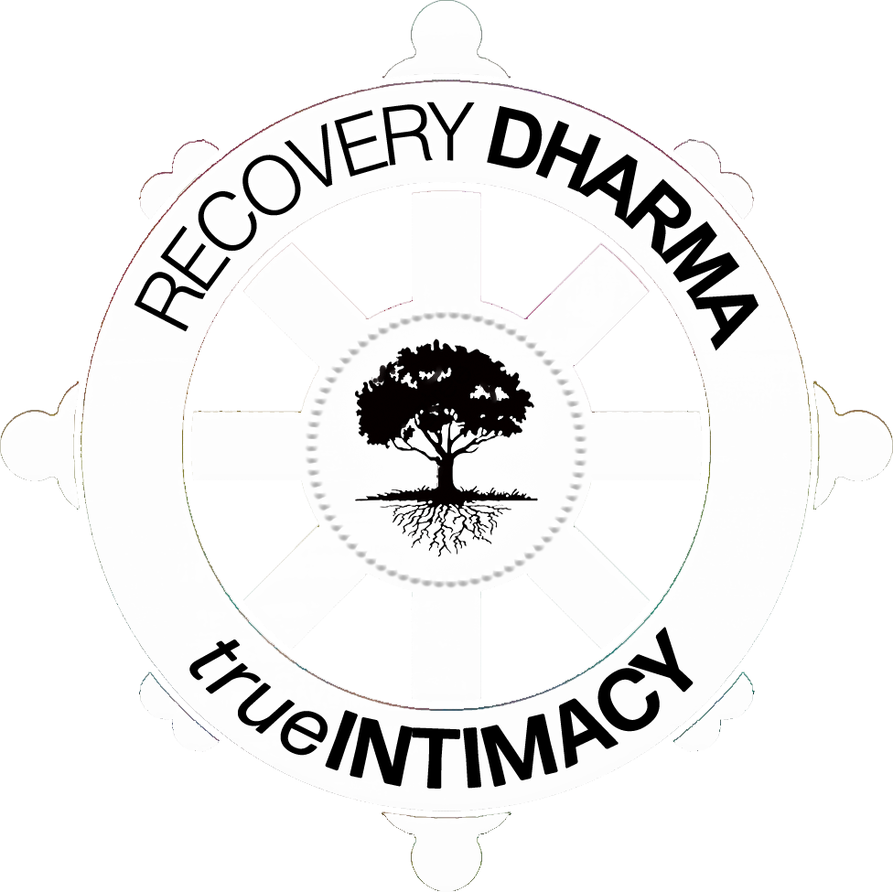
The "Feelings" Bookmark (based on research with Brené Brown's "Atlas of the Heart")
(Pro Tip: it's ok to come up wiith your own words too!)
🙂 | 🙁 | 😔 | 😌 | 😦 | 😤 | 🙏 | 😞 | 🤑 | 💡
Happy | Sad | Hurt | Content | Unsure | Angry | Connected | Lonely | Want-ing | Aware
Amused | Bored | Anguish | Admiration | Anxious | Betrayed | Belonging | Avoidant | Clingy | Appreciative
Confident | Despair | Dread | Calm | Bittersweet | Danger | Empathy | Compared | Controlling | Awe
Empowered | Disappointed | Embarrassed | Comfortable | Confused | Defensive | Fitting In | Dehumanized | Craving | Compassion
Excited | Discouraged | Grief | Humble | Dissociated | Disgust | Heard | Invalidated | Greedy | Curious
Grateful | Guilt | Heartbreak | Nourished | Fear | Frustrated | Honored | Invisible | Envy | Forgiving
Hopeful | Numb | Hopeless | Relieved | Insecure | Hate | Seen | Judged | Hungry | Generous
Joy | Regret | Overwhelm | Safe | Surprised | Humiliated | Supported | Loveless | Lustful | Interested
Loving/Loved | Resigned | Shame | Self-Loving | Triggered | Resentful | Understood | Unheard | Nostalgic | Vulnerable
Proud | Tired | Stressed | Trusting | Worried | Tense | Valued | Unseen | Perfectionist | Wonder
feelings.rd.rocks
Notes:
http://feelings.rd.rocks

Slide 13
The "Human Needs" Bookmark (adapted from Marshall Rosenberg's Research)
🌟 | 🧘‍♂️ | 🤝 | 🌐 | 🎨 | 🌞 | 🌱 | 🕊️ | 😄 | 🍏
Autonomy | Self-Connect. | Connection | Interconnect. | Involvement | Meaning | Growth | Peace | Play | Wellness
Choice | Authenticity | Affection | Belonging | Challenge | Celebration | Awareness | Acceptance | Adventure | Comfort
Dignity | Inspiration | Compassion | Communica. | Communion | Competence | Clarity | Balance | Companion | Exercise
Freedom | Self-Accept. | Empathy | Community | Creativity | Contribution | Consciousness | Beauty | Excitement | Food/Water
Independ. | Self-Care | Friends | Inclusion | Integration | Effectiveness | Discovery | Ease | Fun | Rest/Sleep
Movement | Self-Connect. | Intimacy | Mutuality | Integrity | Efficiency | Growth | Equanimity | Humor | Safety
Self-Express. | Self-Love | Love | Respect | Participation | Progress | Learning | Faith | Joy | Shelter
Space | Self-Respect | Be-Heard | Security | Perspective | Purpose | Nurturing | Harmony | Relaxation | Sexual-Expr.
Spontaneity | Stability | Be-Seen | Shared-Reality | Trust | Presence | Understanding | Hope | Stimulation | Touch
needs.rd.rocks
Notes:
http://feelings.rd.rocks

Slide 14


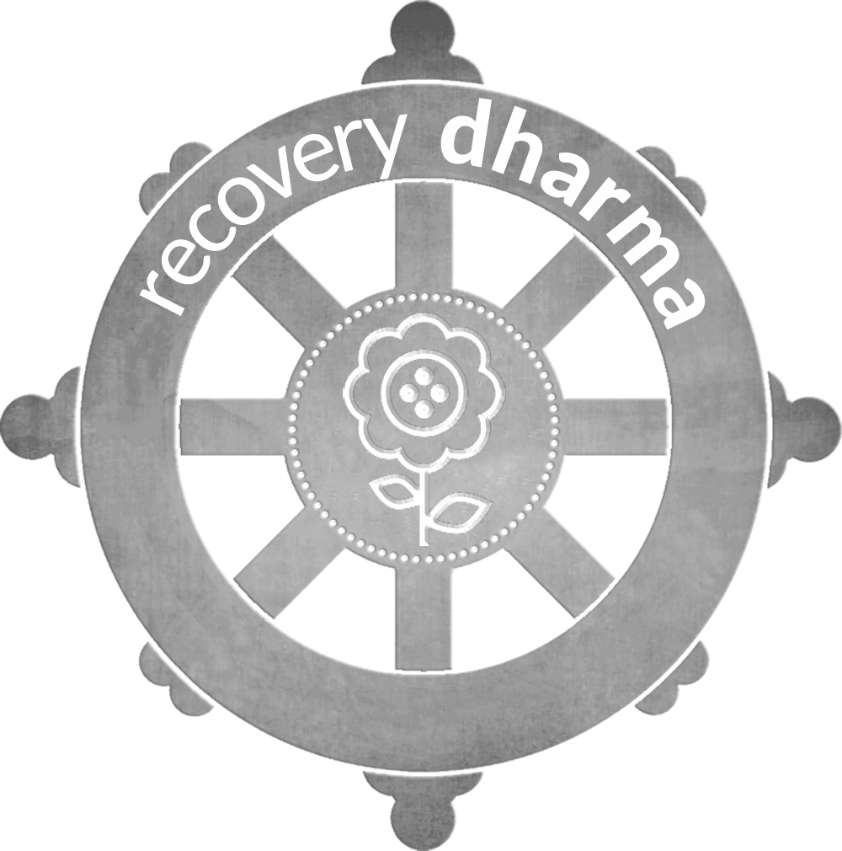
Save this PDF
Customize your own copy of these slides. Use/edit/redo these templates in whatever benefits you most, by:
1️⃣ Going to http://editslides.rd.rocks
2️⃣ Clicking on "File" -> "Make a Copy" -> "Entire Presentation"
(p.s. if you liked these slides, you gotta experience rd.rocks 🤘)
(Copy these slides as a template! http://editslides.rd.rocks )
Notes:
Yes, you can. You are Recovery Dharma. You are invited to share/ remix/ rerelease these slides at anytime. These slides are offered freely as a launchpad. Pretty easy:
1️⃣ Go to http://copyslides.recoverydharma.rocks
2️⃣ Click on File
3️⃣ Make a Copy (or Download)
(p.s. Hey... if you liked these slides, you'll 💓 http://rd.rocks ☸🤘)

Slide 15
Dedication of Merit
(beginners version)
share
sound,
then
play
3x Bells
We dedicate the merits and
Goodwill of this meeting
To all who suffer from addiction.
As we have learned from practice,
Great pain does not erase goodness,
But in fact informs it.
May all who cling
Embrace the freedom of letting go.
May all hearts awaken
To compassion, recovery, and peace.
May all who suffer hold the light,
May all healers share the light,
May our recovery be an offering to all beings.
🔔🔔🔔.
(share this: http://merit.rd.rocks)
Notes:
We dedicate the merits and
Goodwill of this meeting
To all suffering addicts
As we have learned from practice,
Great pain does not erase goodness,
But in fact informs it
May all who cling
Embrace the freedom of letting go
May all hearts awaken
To compassion, recovery, and peace
May all who suffer hold the light
May all healers share the light
May our recovery be an offering to all beings.
🙏 🔔 🙏

